Slide 1
Mobile Game: Initial Concepts
Overview:
Action/Sci Fi sidescroller
“Matrix” style virtual world
Character/Item Personalization
RPG Elements
Multiple arenas of combat
Single and Multiplayer
Monetization

Slide 2
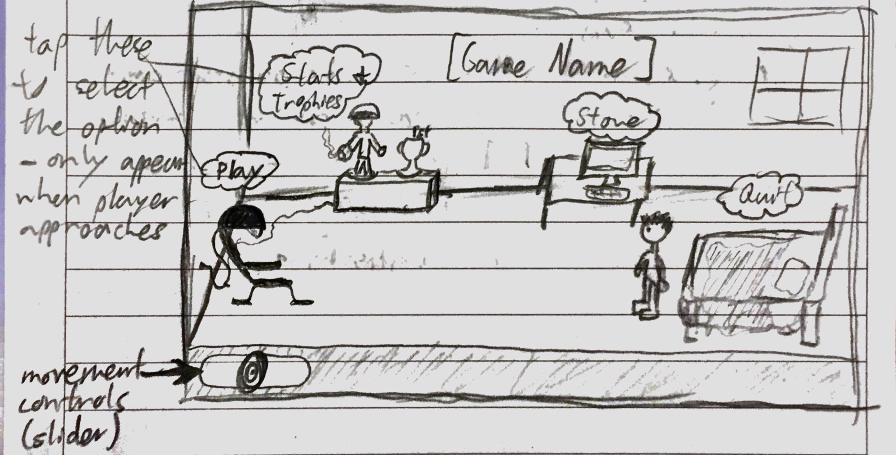
Game World
Player’s character is a player in VR tournament-based game, through which people can become rich famous badasses
Enemies: Other players (real ppl) or virtual bots -> avoids gore
Main Menu: Player’s Apartment (can be upgraded w/ game cash)
Different areas = different menu options

Slide 3
Game Modes
Missions
Short (3-5 min) levels
Start and end goal – goals vary based on mission
Unlock new areas with progress
Players can summon other players for help (summon items are consumables and can be purchased)
Survival
Single or Multi, player’s pick
Time = as long as players survive (can be paused for breaks)
Continuous waves of enemies with increasing difficulty
“Boss” characters end a wave
Players get random item drops from achievements, like finishing under a certain time or without getting damage
Battle
Player vs. Player
Get lots of XP from wins, can test your character in “real” fight

Slide 4
Gameplay
RPG Elements
Talent tree with branching powers
Customization – gender, face, armor colors
3 Weapon Pick – player begins journey by choosing first gun; others can be bought later
Action
Powers used on a timer, guns have unlimited ammo but may need to reload
Fast paced action with some mechanical assistance (aiming)
Challenge
Should work as a cycle
Starts difficult-> player gets experience/skill-> player progresses to next stage, feels like a boss-> game gets difficult again
Cycle can be “sped up” using store purchases, but can’t be broken – game will inevitably become difficult again
Greater Challenge = Greater Player Investment

Slide 5
User Interface
Need to account for:
Weapons & Powers
Health/Shields
Points/XP
Movement & Combat controls
Info Presented
Enemy health: over heads/small when passive, bottom of screen/large when targeted
Action Buttons:
2 ranged weapons, 1 melee (switch in top right)
Fire/Use Power (bottom right)
Move left/right (slider, bottom left)
Jump (swipe up on screen, or next to move slider)

Slide 6
Name
VRGE
“VR” = Virtual Reality; game takes place in simulated game world, so it makes sense
“Verge” sounds sci-fi and weird, matches tone of game
That’s my only idea. I’m bad at naming. Let’s brainstorm!

Slide 7

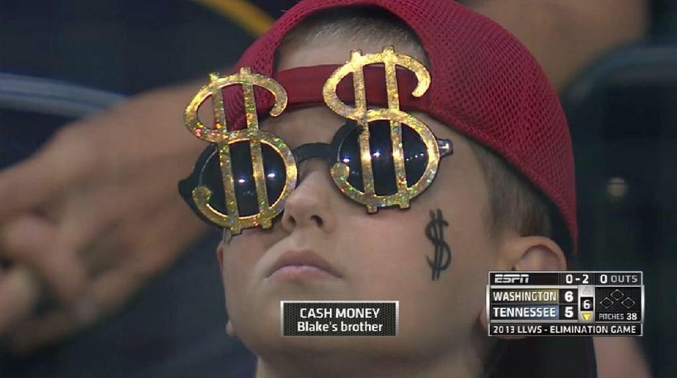

Monetization
Game Currency
Data = normal currency; buys standard consumables, some weapons and armor
Also counts as player experience
Cores = special currency; buys extra awesome weapons and armor, special consumables (ex: player summon item)
Optional Ads
Can be watched before matches, to boost XP gained
Game Store
New weapons, armor

